Slide 1

INVENTORY ORDER MANAGEMENT SYSTEM

Slide 2
MENTOR
KASALANATI PAVAN

Slide 3
Team Members
Divyansh Khatri
Yashwanth Mukka
Teja Akarapu
Vaishnavi Nookala

Slide 4
REQUIREMENTS
1.Customer Orders
Different states for an order
Not Confirmed
Confirmed
Shipped
Delivered
Cancelled

Slide 5
REQUIREMENTS
2.Purchase Orders
Different states for a purchase
Draft
Raised
Received
Closed
Cancelled

Slide 6
REQUIREMENTS
3.Products
Product Details
Available
On Hand
Outgoing
Incoming
Cost Price
Selling Price
OnHand=Available-Outgoing

Slide 7
REQUIREMENTS
Graphs
1.Total orders from customers
2.Purchase orders: show graph for each state
3.Same for customer orders

Slide 8
TECHSTACK
Angular 11
Java 8
Spring Framework
H2 Database

Slide 9
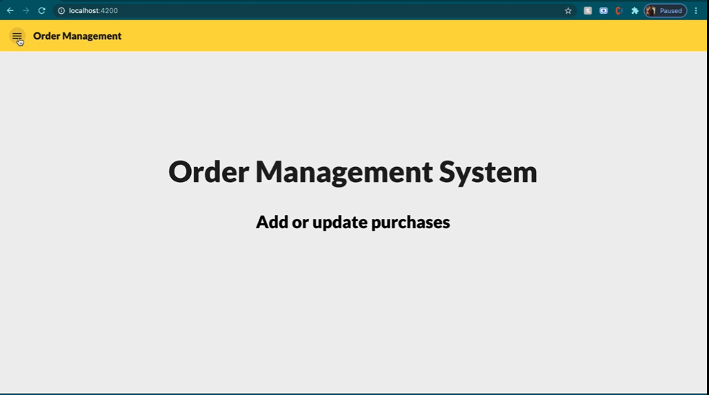

Slide 10
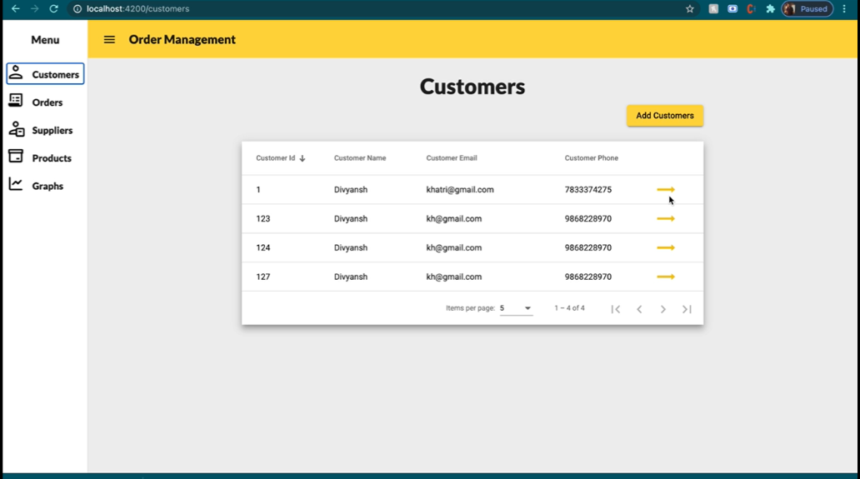

Slide 11
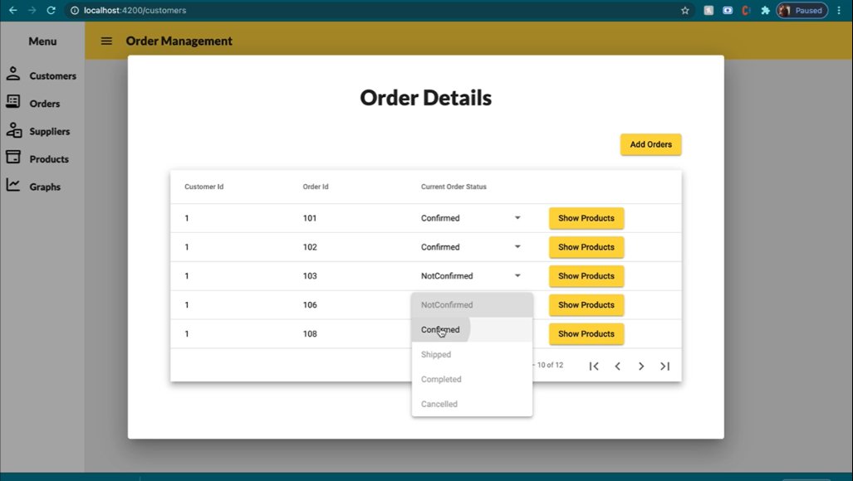

Slide 12
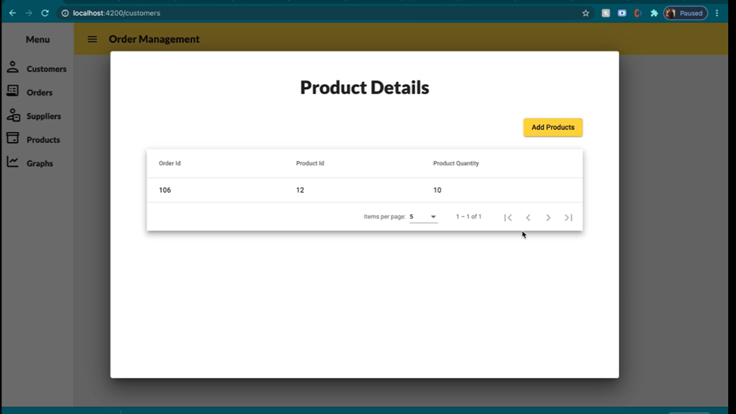

Slide 13
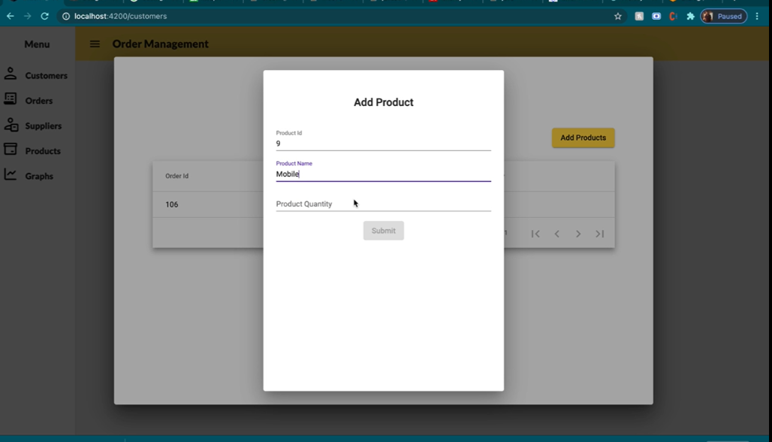

Slide 14
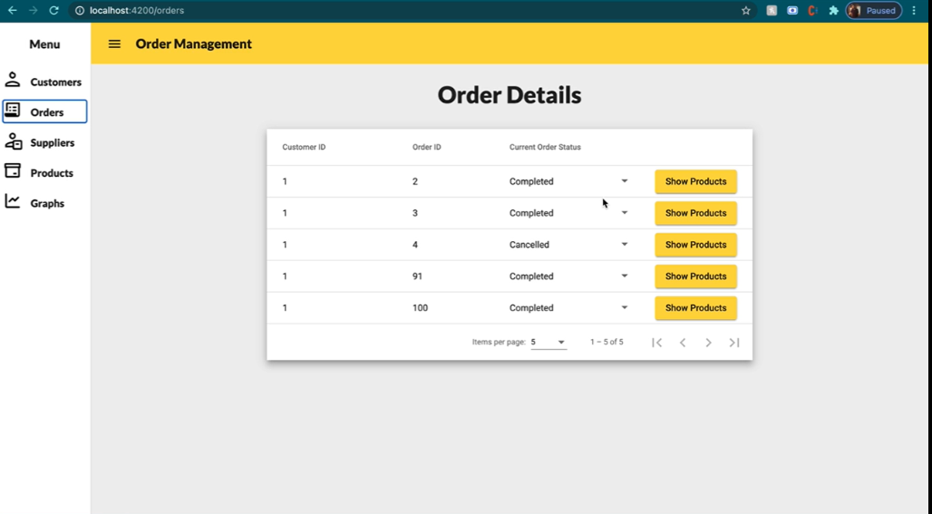

Slide 15
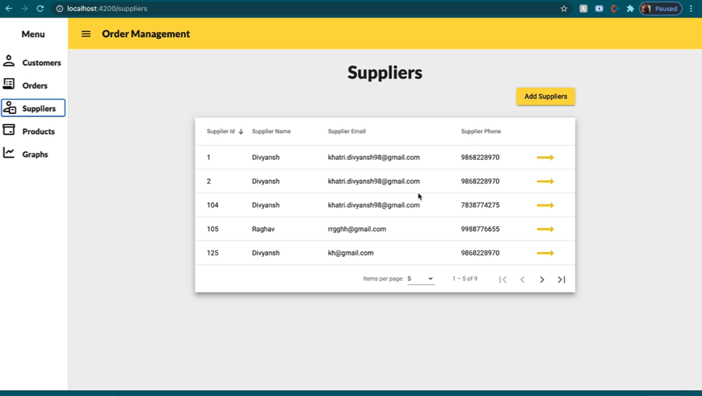

Slide 16
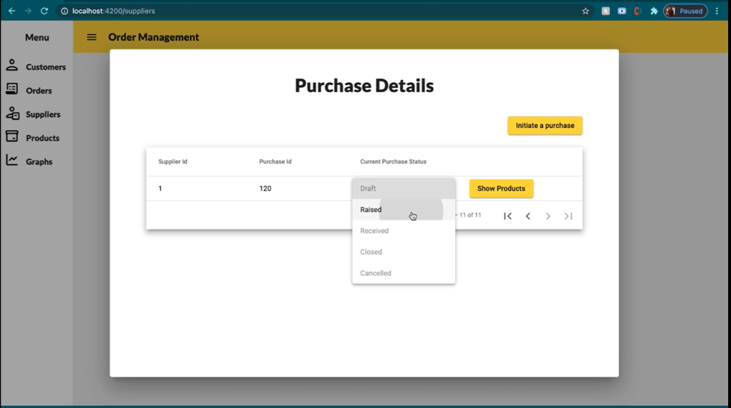

Slide 17
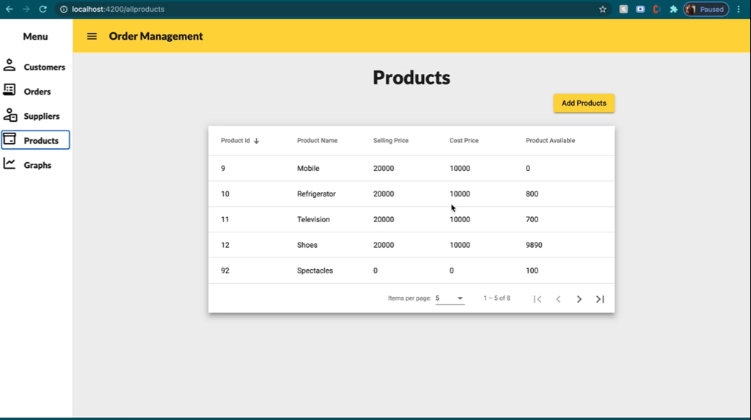

Slide 18
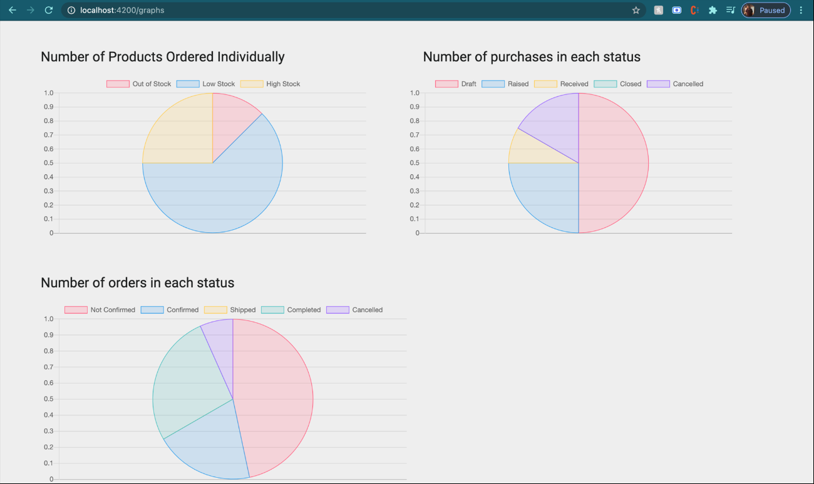

Slide 19
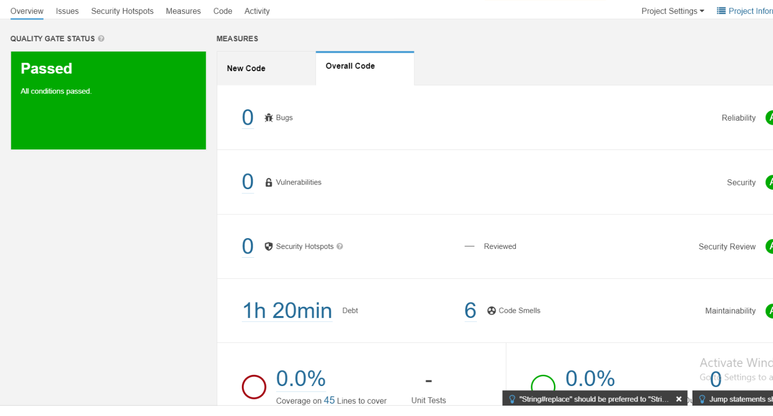

Slide 20
THANK YOU

